Slide 1
MEDIFEEDBACK PORTAL
CAPSTONE PROJECT
Presented By:
GULLAPALLI SHEETAL
KL UNIVERSITY – HYDERABAD BACHUPALLY
AICTE ID - STU681edf42b90491746853698

Slide 2
OUTLINE
Problem Statement (Should not include solution)
System Development Approach (Technology Used)
Algorithm & Deployment (Step by Step Procedure)
Result
Conclusion
Future Scope(Optional)
References

Slide 3
Problem Statement
Patient satisfaction is a key indicator of healthcare quality and hospital performance. Traditional feedback methods, like paper forms, are often inefficient and difficult to analyze. To address this, there is a growing need for a digital system that captures patient feedback effectively and provides actionable insights. This project focuses on developing a user-friendly satisfaction survey platform that collects and analyzes patient experiences related to services, staff behavior, cleanliness, and overall care. The system aims to support hospital management in identifying areas for improvement, enhancing patient-centered care, and promoting transparency and accountability within the healthcare environment.
Hospitals often struggle to efficiently collect, analyze, and utilize patient feedback due to outdated, manual methods that are time-consuming and lack actionable insights. This limits their ability to identify service gaps and improve patient care. There is a need for a digital solution that enables structured, real time collection and analysis of patient satisfaction data to support data-driven decisions and enhance the overall healthcare experience.

Slide 4
System Approach
Frontend: HTML, CSS, JavaScript, React.js (or Angular)
Backend: Node.js with Express / Java (Spring Boot) / Python (Django or Flask)
Database: MySQL / MongoDB
Authentication & Security: JWT (JSON Web Token), HTTPS, password hashing
Payment Gateway Integration: PayPal / Razorpay / Stripe
Deployment: AWS / Heroku / Azure / Netlify (for frontend)

Slide 5
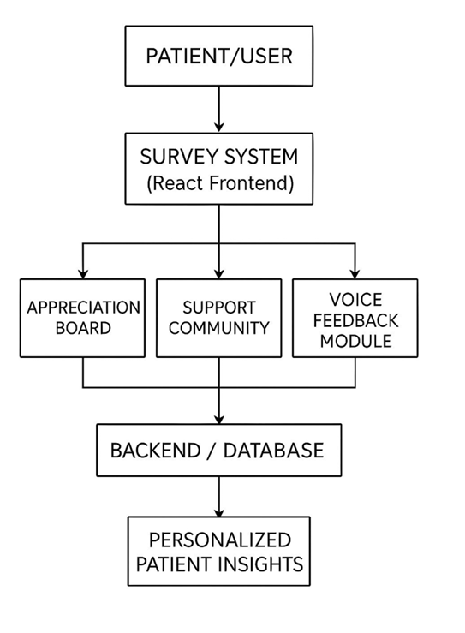
Algorithm & Deployment

Slide 6
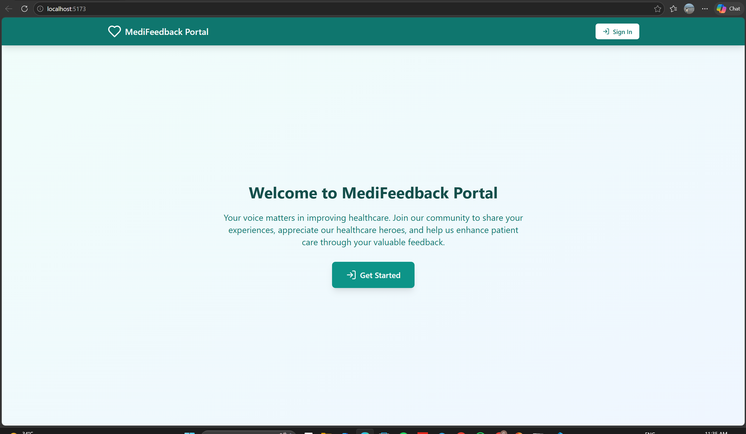
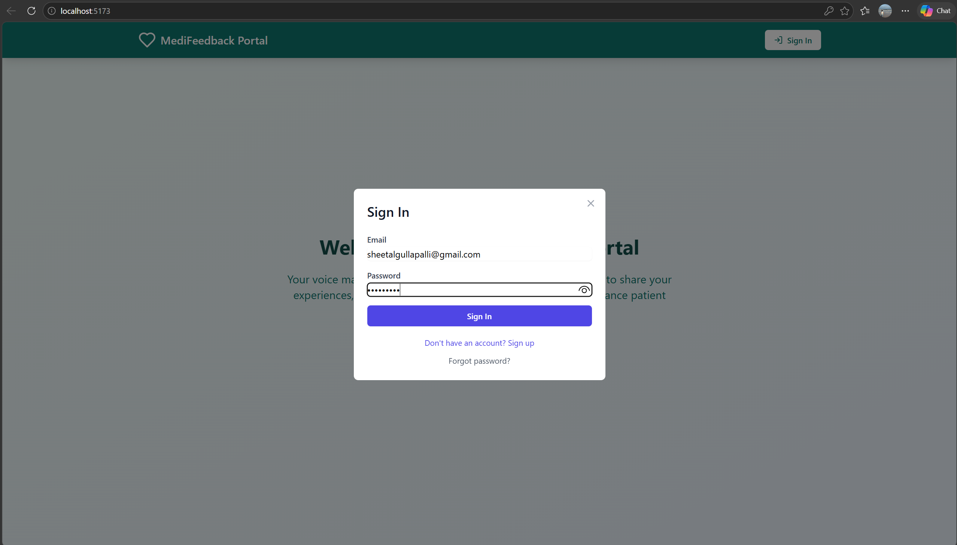
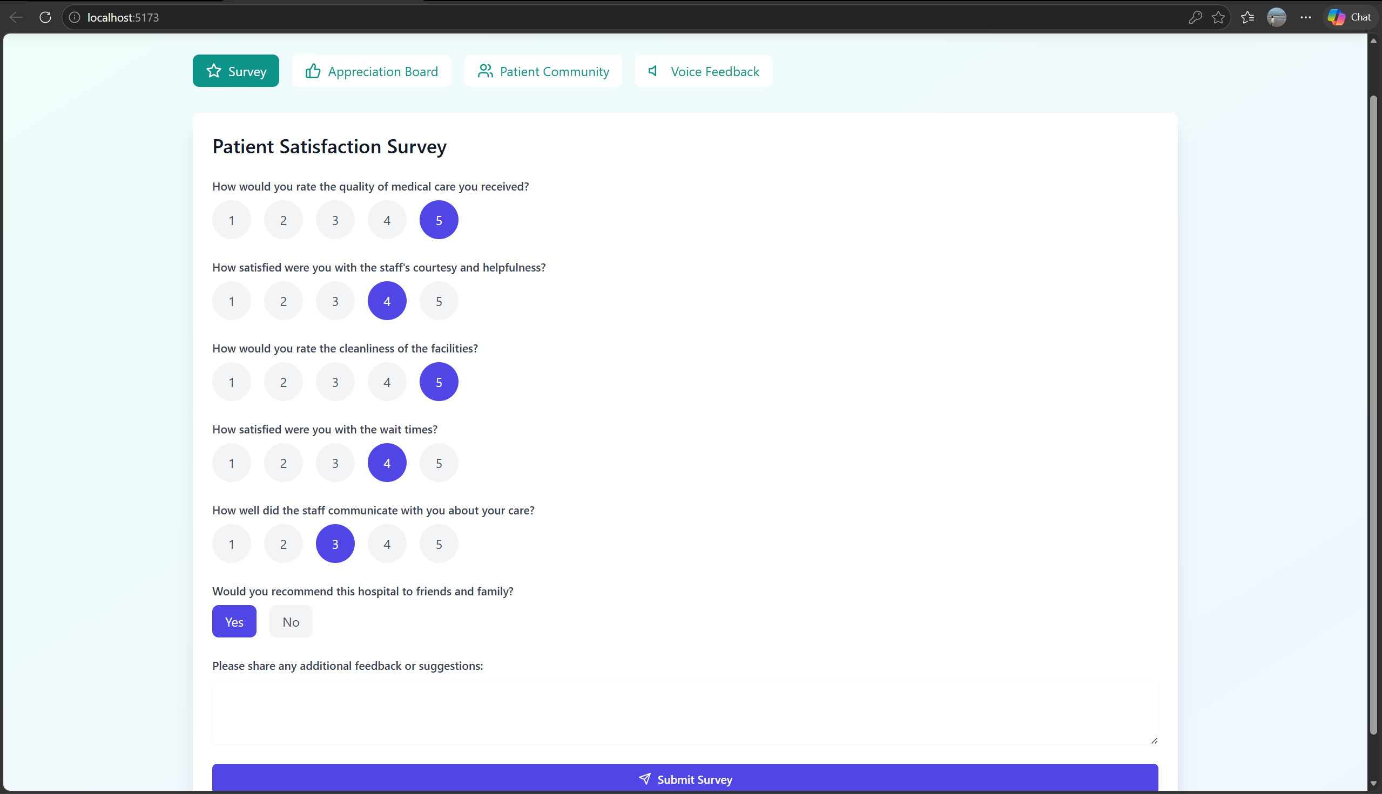
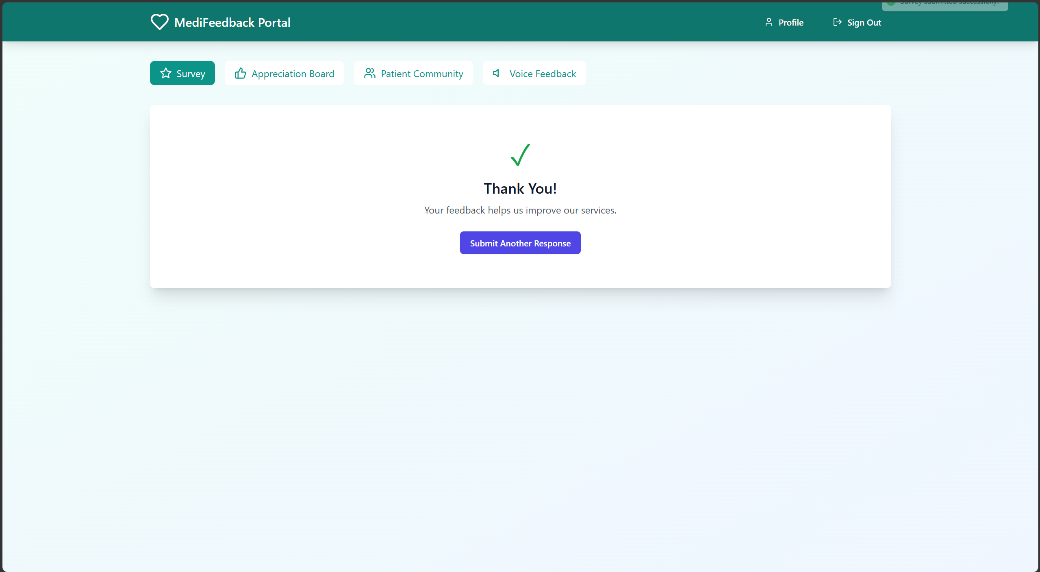

Slide 7
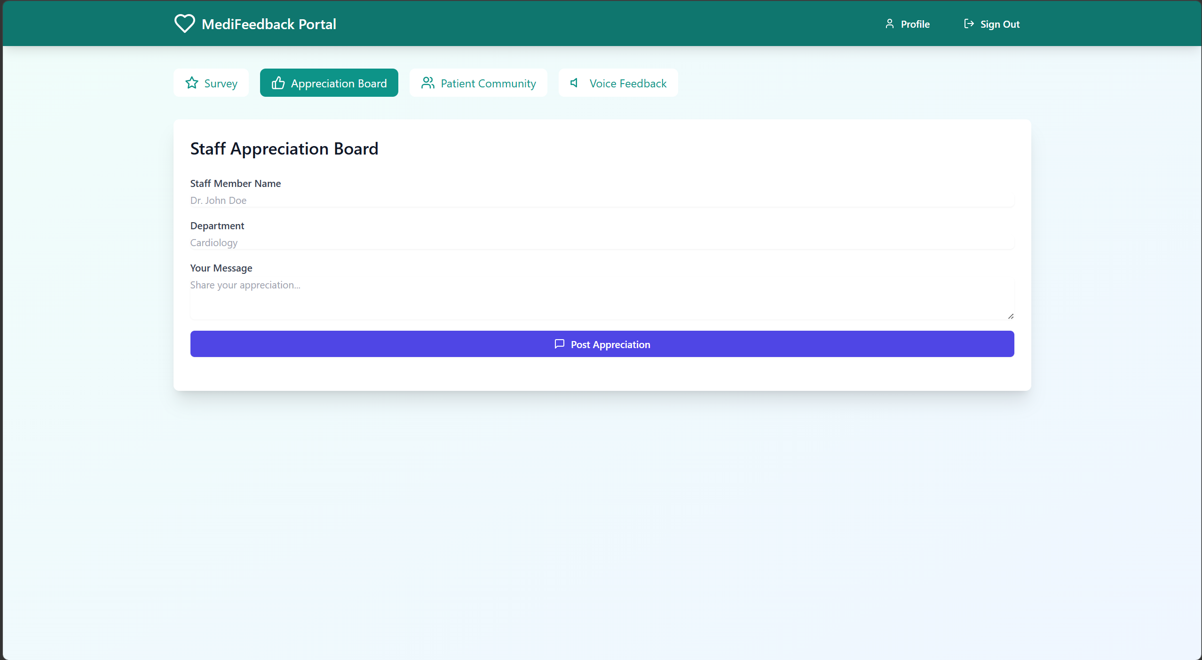
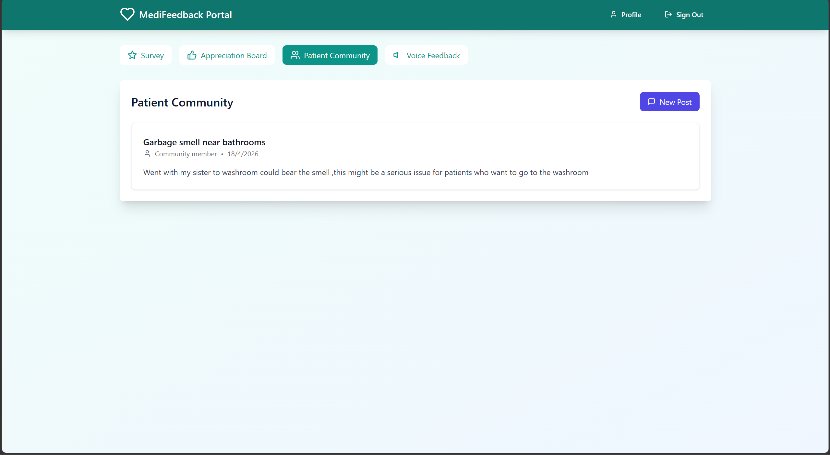
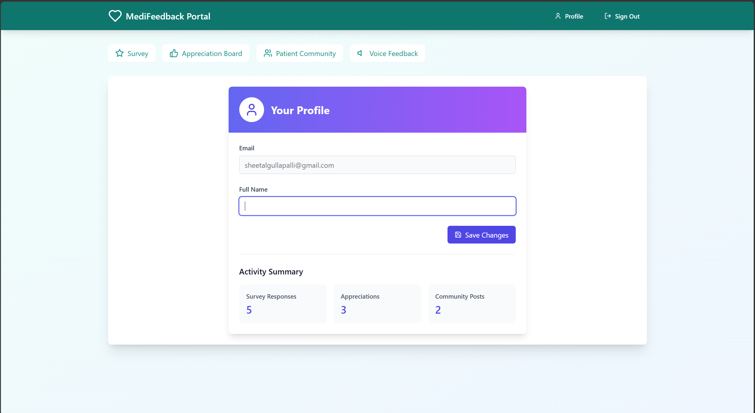
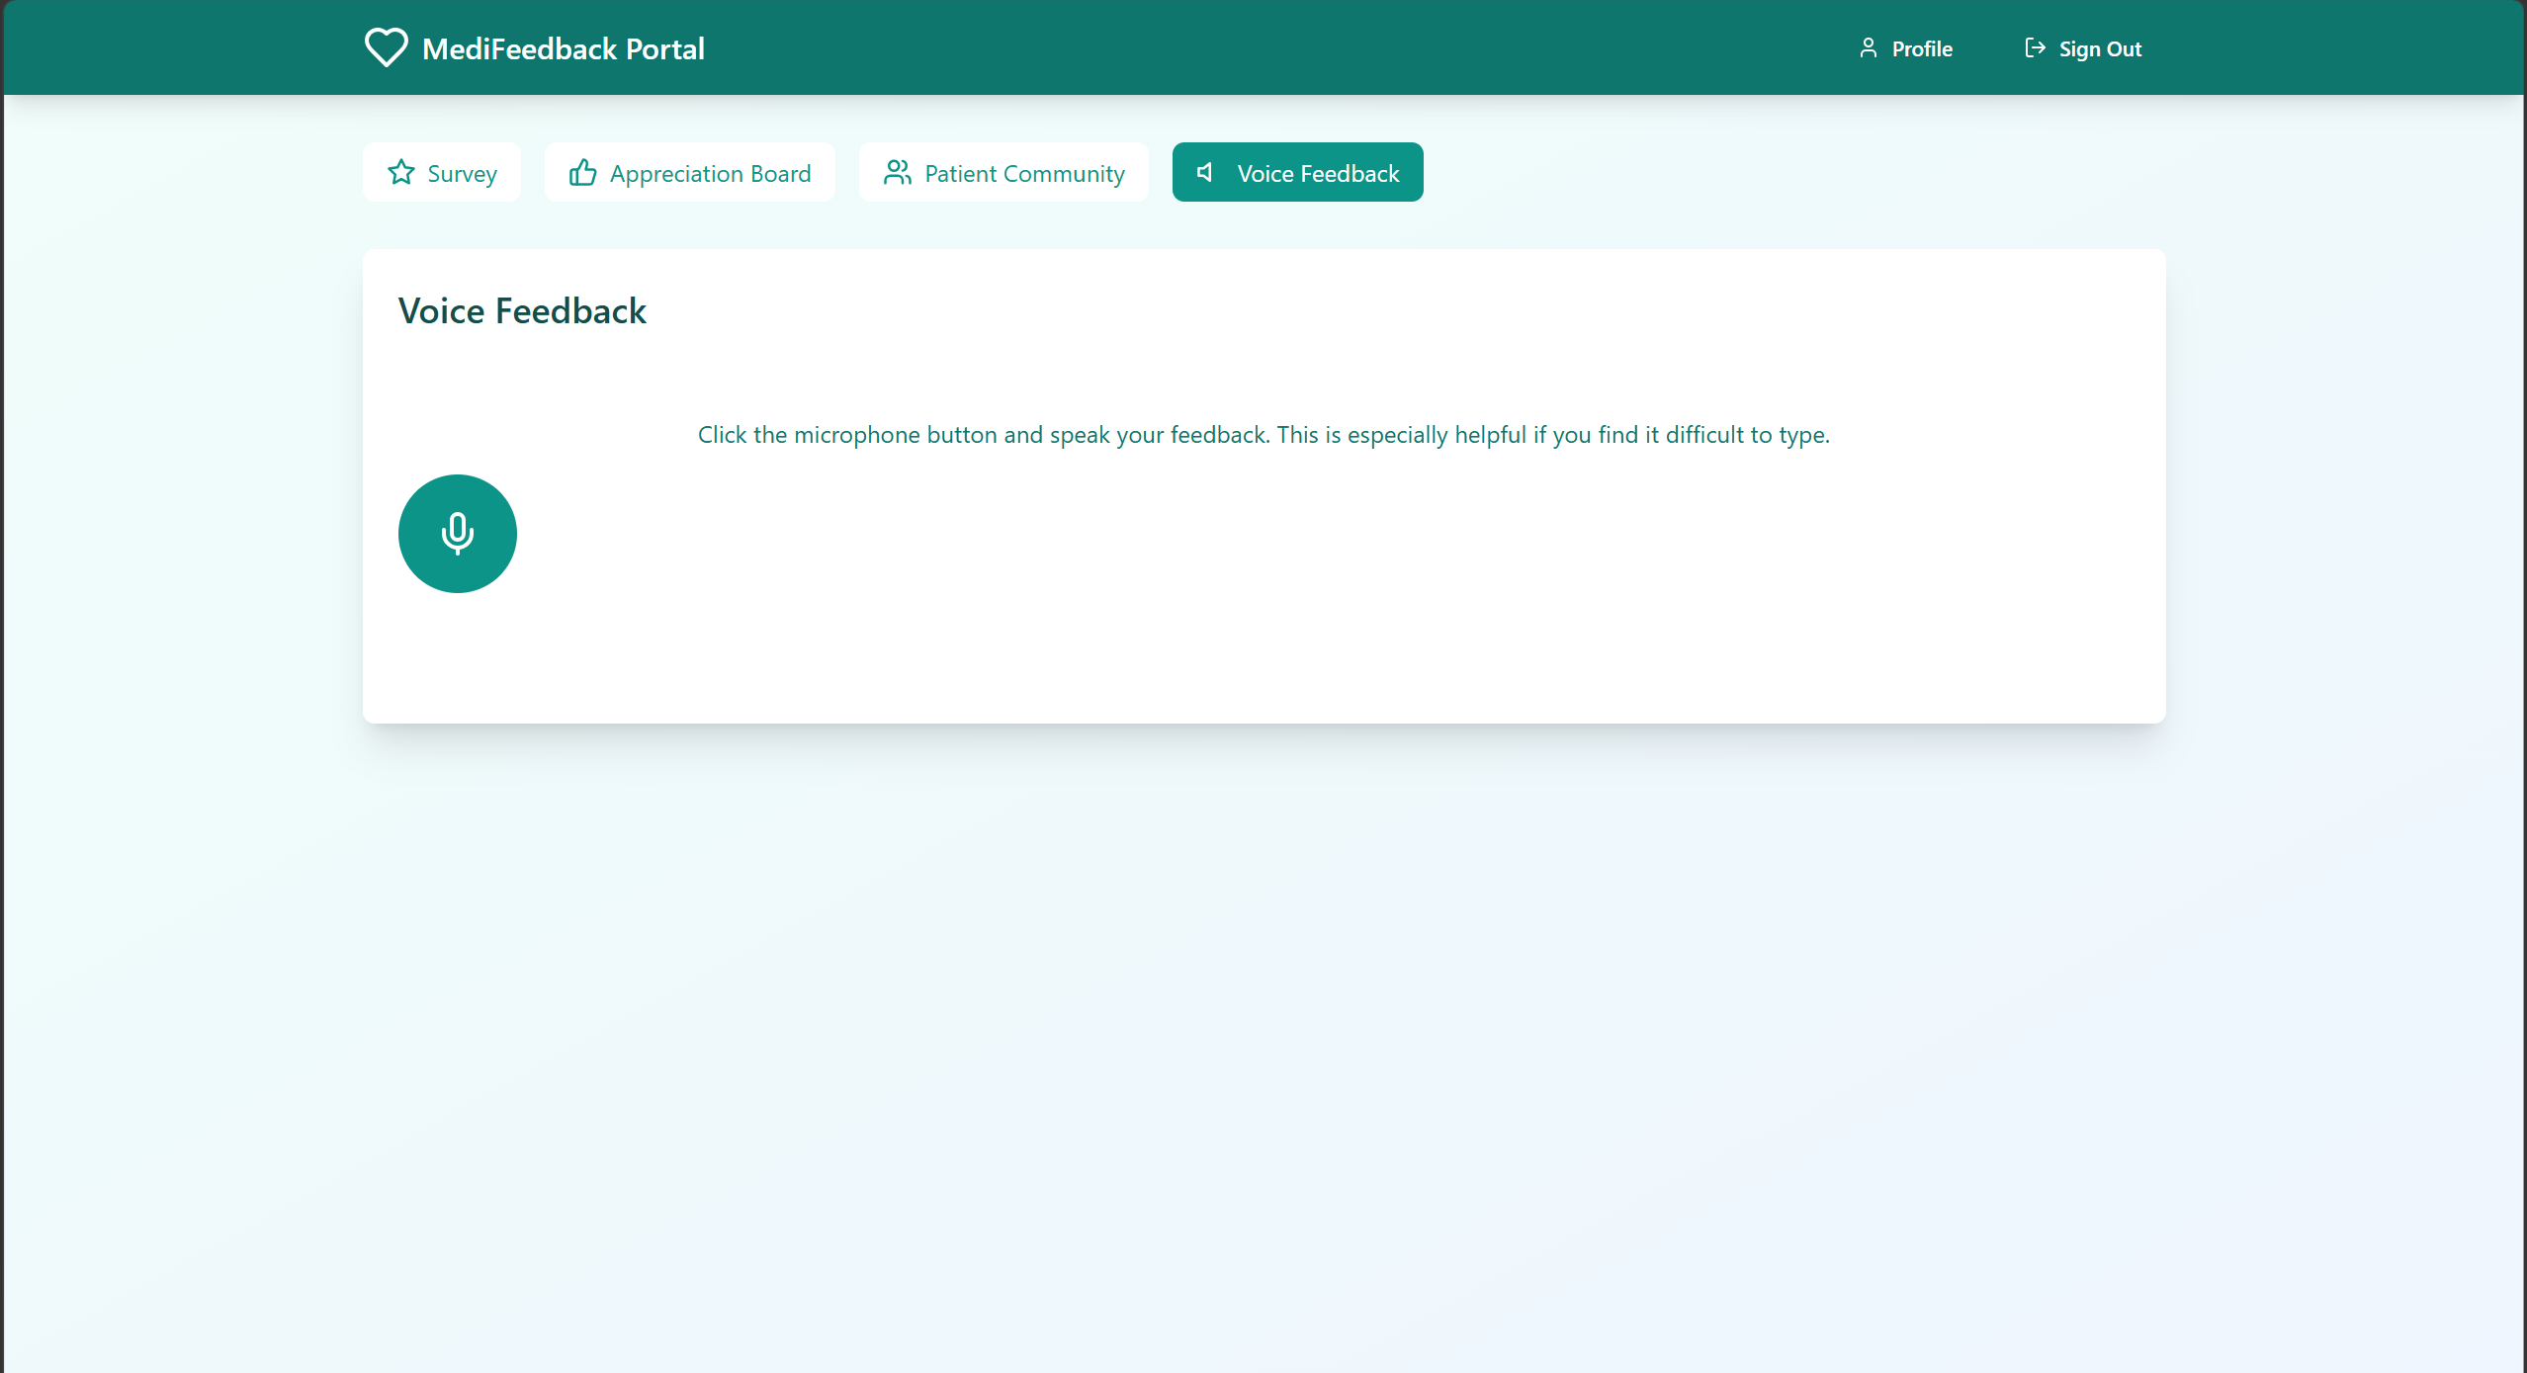

Slide 8
Result
This project aimed to improve patient engagement and satisfaction through an interactive hospital survey and feedback system. Key features include a real-time appreciation board, anonymous support community, personalized insights, and voice based feedback options—all integrated into a seamless web application.
Github link
https://github.com/sheetal-092/INTERNSHIP_SUBMISSION.git
Video link
https://drive.google.com/file/d/1nz9J7SdbwSFpCRDFwqQx5m6cHbG2ur27/view?usp=sharing

Slide 9
Conclusion
This project aimed to improve patient engagement and satisfaction through an interactive hospital survey and feedback system. Key features include a real-time appreciation board, anonymous support community, personalized insights, and voice based feedback options—all integrated into a seamless web application.

Slide 10
Future scope(Optional)
Mobile application development (Android & iOS).
Integration of Artificial Intelligence for personalized recommendations.
Advanced analytics dashboard for admin.
Integration of Augmented Reality (AR) for virtual product try-on.
Multi-language and multi-currency support for global reach.

Slide 11
References
W3Schools – https://www.w3schools.com
MDN Web Docs – https://developer.mozilla.org
React Official Documentation – https://reactjs.org
Node.js Documentation – https://nodejs.org
Django Documentation – https://docs.djangoproject.com

Slide 12
THANK YOU

